Slide 1
Mitigating Supply Chain Disruptions: Predicting Late Delivery Risks for Enhanced Operational Efficiency
By
Madhunika Shetty
Sneha Kuder
Sanju Sakthivel – Representative
Varshini Sree J K
Ganesh Kumar
Suman

Slide 2
PROJECT TITLE
Mitigating Supply Chain Disruptions: Predicting Late Delivery Risks for Enhanced Operational Efficiency

Slide 3
PROBLEM STATEMENT
In the realm of supply chain management, the ability to predict and mitigate late delivery risks is paramount for ensuring operational efficiency and customer satisfaction. This project aims to develop a predictive model that identifies potential delays in deliveries within the supply chain. By harnessing advanced analytics and machine learning techniques, we seek to empower businesses with the foresight to anticipate and address these risks proactively, thereby minimizing disruptions and optimizing overall supply chain performance.

Slide 4
BUSINESS UNDERSTANDING
Efficient supply chain management is essential for businesses to meet customer demands, maintain competitiveness, and drive profitability.
However, delays in deliveries can disrupt operations, lead to customer dissatisfaction, and incur additional costs
Predicting and mitigating late delivery risks is crucial for enhancing supply chain efficiency and ensuring smooth operations.
The proposed project seeks to address this challenge by developing a predictive model that identifies and assesses the likelihood of late delivery risks within the supply chain.
By leveraging historical data, real-time information, and advanced analytical techniques, the model aims to provide actionable insights to supply chain managers and decision-makers.

Slide 5
APPROACH
Data collection and Preprocessing
Feature Engineering
Model Selection
Model development and Training
Development of web interface
Real time Monitoring and Prediction
Feedback Loop and Model Refinement
Deployment and Integration

Slide 6
DATA UNDERSTANDING
DATA SOURCES
Our primary data source is our company's historical sales database, packed with valuable insights. We might also peek into external sources for market trends or customer feedback to enrich our predictions.
Link : https://www.kaggle.com/datasets/shashwatwork/dataco-smart-supplychain-for-big-data-analysis

Slide 7

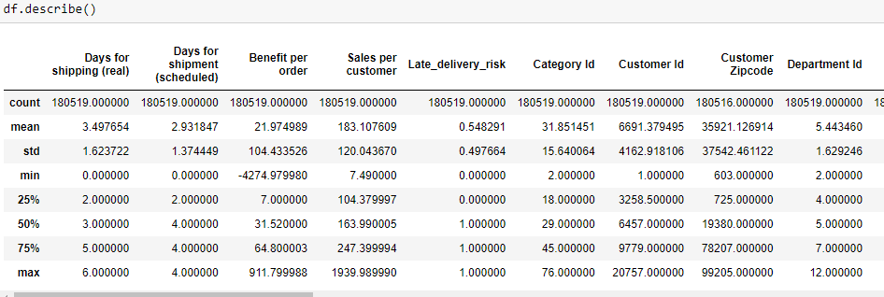
SUMMARY OF THE DATASET
Dataset Summary

Slide 8
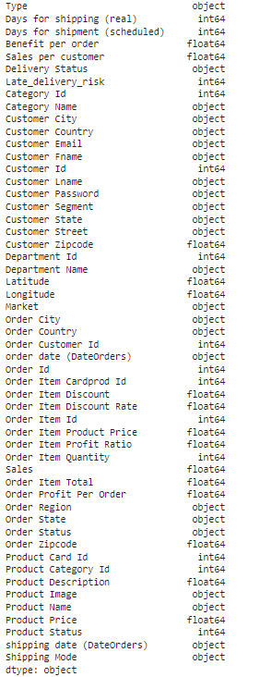
SUMMARY OF THE DATASET
Dataset Summary – data types

Slide 9
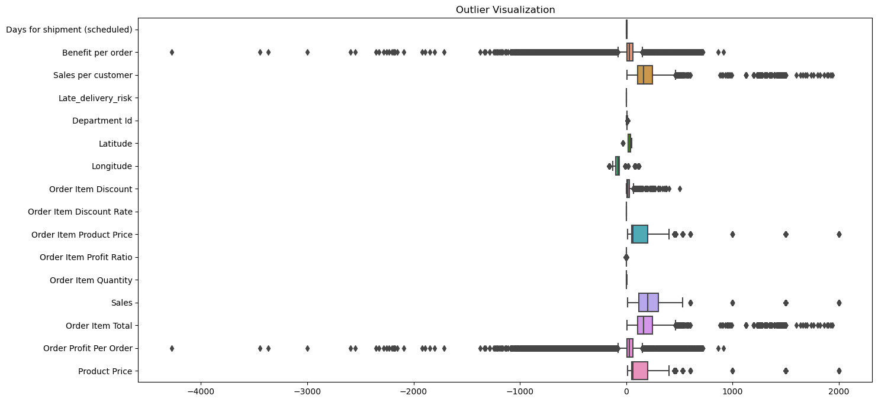
EXPLORATORY DATA ANALYSIS
1. Outlier Visualization

Slide 10
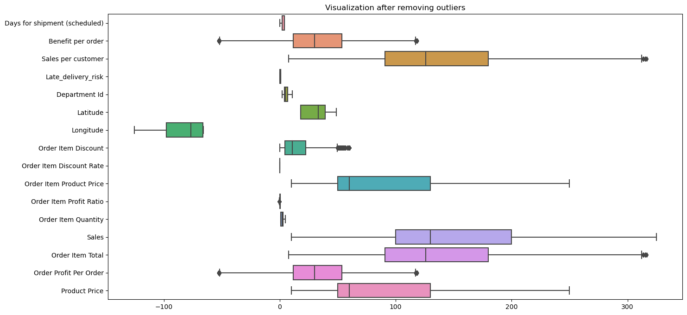
EXPLORATORY DATA ANALYSIS
2. Visualization after removing outlier

Slide 11
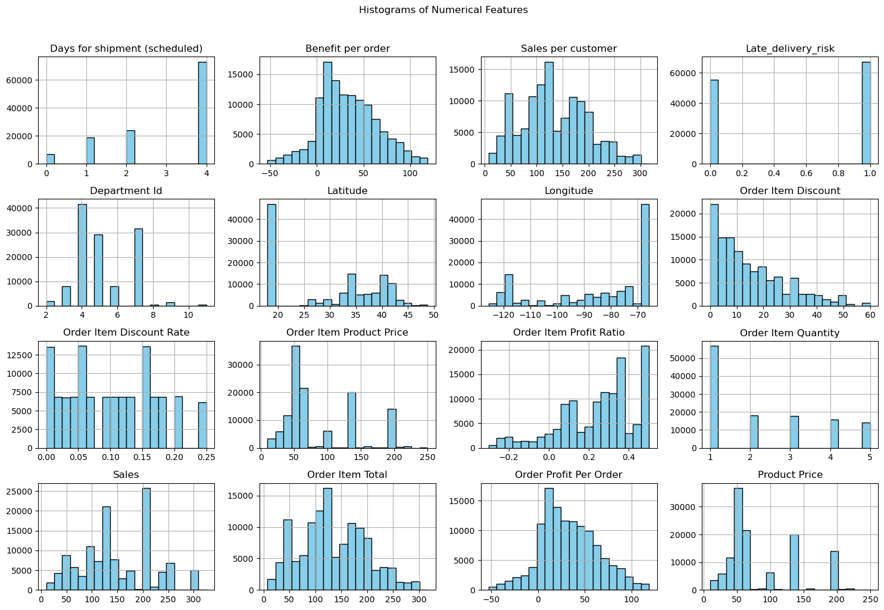
EXPLORATORY DATA ANALYSIS
3. Histogram of Numerical Features

Slide 12
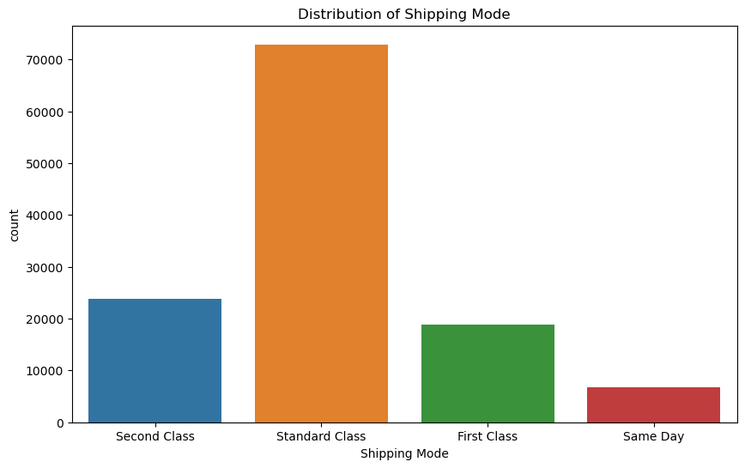
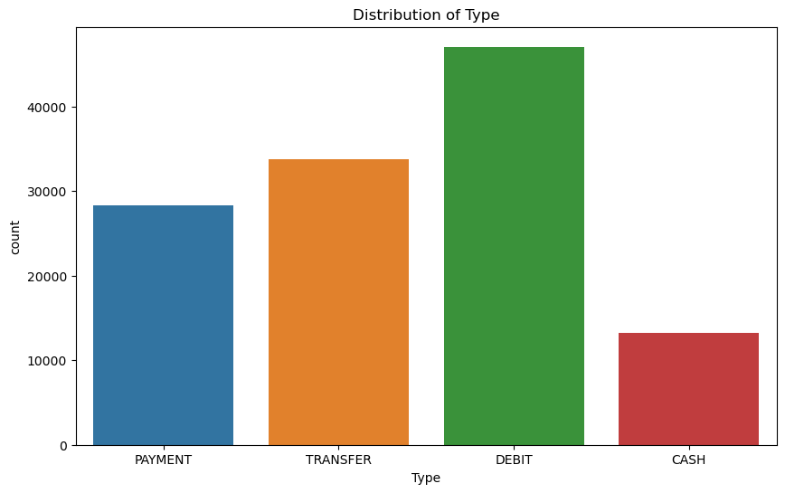
EXPLORATORY DATA ANALYSIS
4. Visualization of Categorical Columns

Slide 13
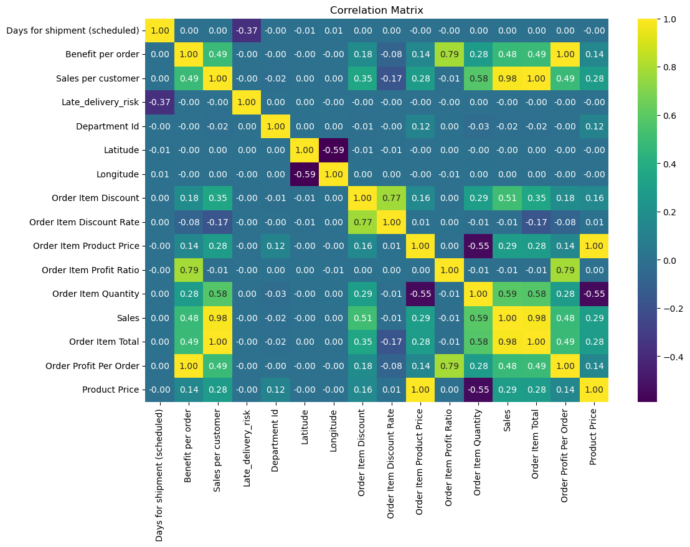
EXPLORATORY DATA ANALYSIS
5. Correlation Analysis

Slide 14
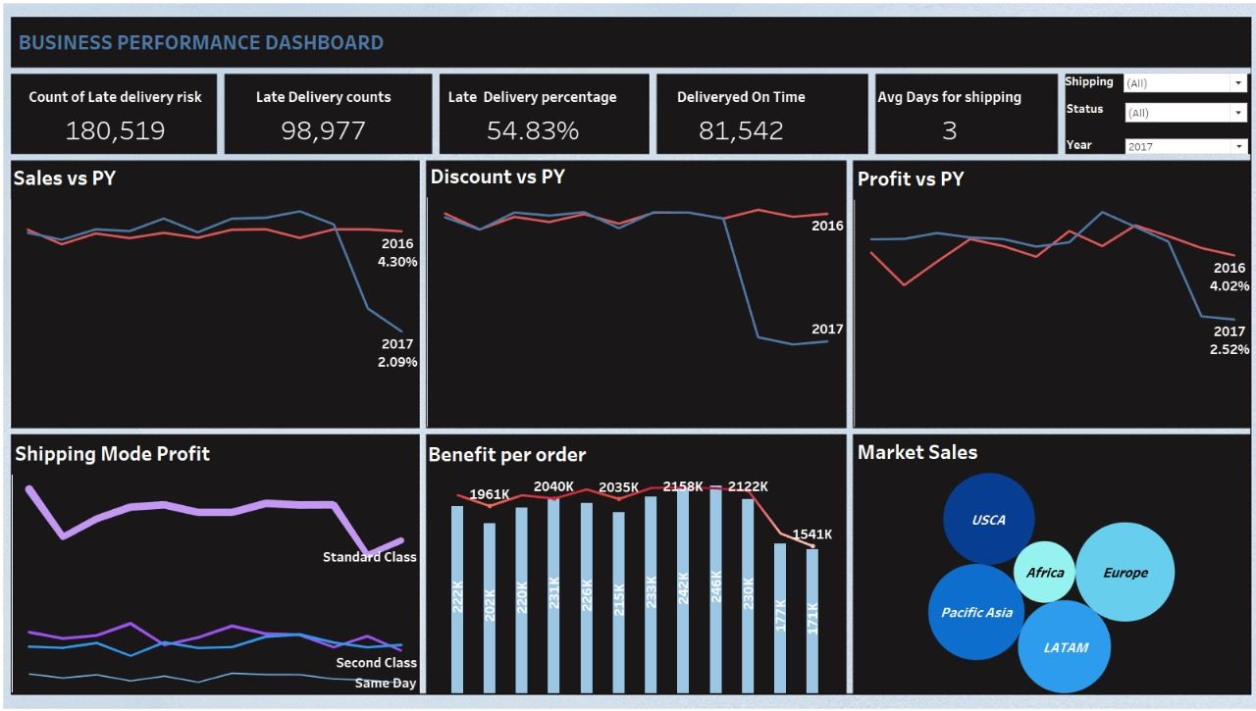
DATA VISUALIZATION
TABLEAU DASHBOARD
Data visualization refers to the graphical representation of data and information through charts, graphs, maps, and other visual elements
Tableau is a powerful and widely-used data visualization tool that enables users to create interactive and insightful visualizations from various data sources
Dashboards in Tableau are powerful tools for combining multiple visualizations into a single interactive interface, allowing users to explore and analyse data from various perspectives.

Slide 15

DATA PREPARATION
As part of data preparation the following points have been considered and implemented.
Missing Value analysis
Encoding Categorical Variables

Slide 16
DATA MODELLING
The following are the models that have been tried
Random Forest Classifier
Gradient Boosting Classifier
(CART) Decision Tree Classifier
XG-Boost Classifier

Slide 17
MODEL DEPLOYEMENT
Web Interface Development with HTML, CSS, JavaScript, and FastAPI:
Utilized HTML, CSS, and JavaScript to design and develop an intuitive and user-friendly web interface that provides seamless interaction with the deployed machine learning model.
Integrate the FastAPI framework on the server-side to handle HTTP requests, route endpoints, and interact with the machine learning model for inference.
Model Tracking with MLflow:
Utilized MLflow, an open-source platform for managing the end-to-end machine learning lifecycle, to track and manage experiments, models, and artifacts seamlessly.
Monitor model performance and drift over time using MLflow's model serving and monitoring capabilities, enabling proactive intervention and retraining as needed.

Slide 18
CONCLUSION
Among the models tested (Random Forest, Gradient Boosting, Decision Tree, XGBoost), XGBoost performed well in terms of accuracy and AUC-ROC score, Precision and Recall.

